Slide 1

Physics 1
Voronkov Vladimir Vasilyevich

Slide 2
Lecture 6
Heat flow and the first law of thermodynamics.
Kind of thermodynamic process. Adiabatic processes.

Slide 3
Heat
When the temperature of a thermal system in contact with a neighboring system changes, we say that there has been a heat flow into or out of the system.
An energy unit related to thermal processes is the calorie (cal), which is defined as the amount of energy transfer necessary to raise the temperature of 1 gram of water by 1 degree (from 14.5°C to 15.5°C).

Slide 4
Mechanical equivalent of heat
Mechanical energy is not conserserved in the presence of nonconservative forces. It transforms into internal energy. For example, friction produces heating
1 cal = 4.186 J

Slide 5
Specific heat capacity
The heat capacity C of a particular sample of a substance is defined as the amount of energy needed to raise the temperature of that sample by 1 °C.
C=Q/ΔΤ
The specific heat capacity c of a substance is the heat capacity per unit mass.
c=C/m=Q/(mΔΤ)
Specific heat is essentially a measure of how thermally insensitive a substance is to the addition of energy. The greater a material’s specific heat, the more energy must be added to a given mass of the material to cause a particular temperature change.

Slide 6
Energy transfer and specific heat capacity
From this definition, we can relate the energy Q transferred between a sample of mass m and specific heat capacity c of a material and its surroundings to a temperature change ΔT as
Q=mc ΔT

Slide 7

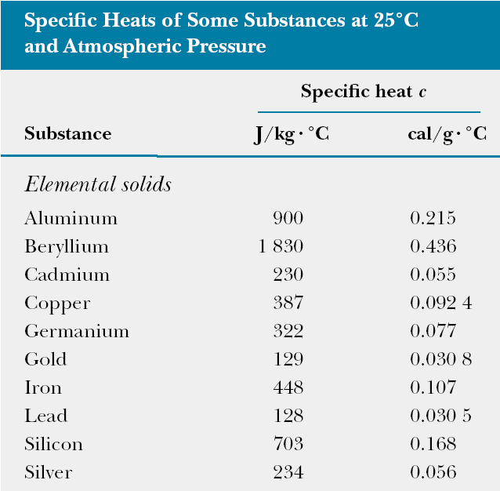
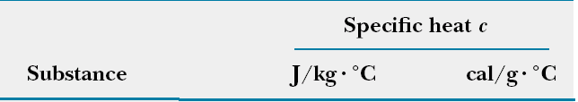
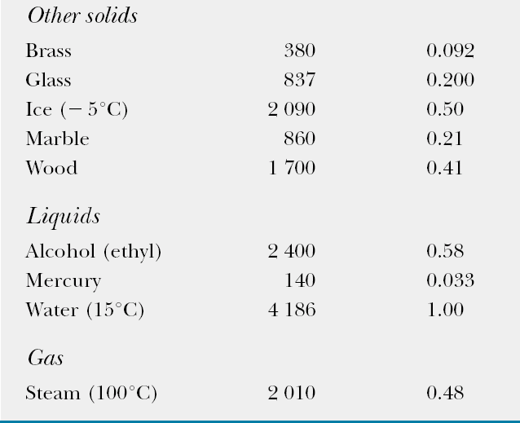

Slide 8
Dependence of specific heat capacity on temperature
Specific heat varies with temperature. For example, the specific heat of water varies by only about 1% from 0 c °C to 100 °C at atmospheric pressure. Usually such variations are negligible.

Slide 9
Dependence of specific heat capacity on volume and pressure
Measured values of specific heats are found to depend on the conditions of the experiment. In general, measurements made in a constant pressure process are different from those made in a constant volume process. For solids and liquids, the difference between the two values is usually no greater than a few percent and is often neglected.

Slide 10
Phase transition
It can be that transfer of energy does not result in a change in emperature. This is the case when the physical characteristics of the substance change from one form to another; such a change is called a phase change. Two common phase changes:
  melting: from solid to liquid
  boiling: from liquid to gas
  change in the crystalline structure of a solid
All such phase changes involve a change in internal energy but no change in temperature.
The increase in internal energy in boiling, for example, is represented by the breaking of bonds between molecules in the liquid state; this bond breaking allows the molecules to move farther apart in the gaseous state, with a corresponding increase in intermolecular potential energy.

Slide 11
Latent heat
Quantitative measure of phase transition is latent heat L:
Q=±mL
Latent heat of fusion L_{f} is the term used when the phase change is from solid to liquid,
Latent heat of vaporization L_{v} is the term used when the phase change is from liquid to gas (the liquid “vaporizes vaporizes”).

Slide 12
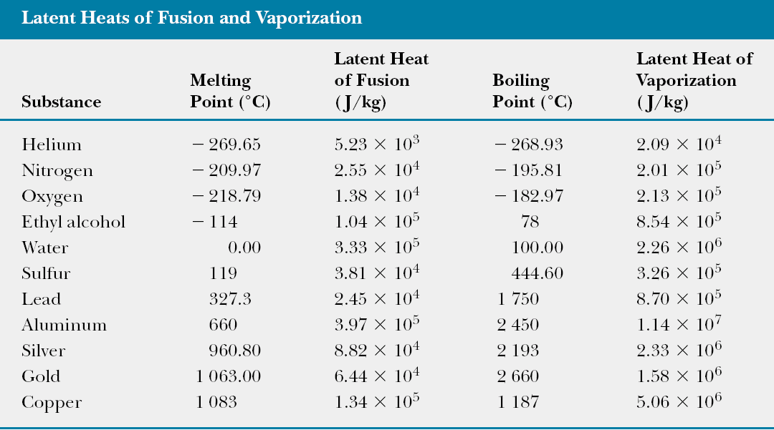

Slide 13
State variables - Thermodynamic process - Thermal equilibrium
We describe the state of a system using such variables as pressure, volume, temperature, and internal energy. These quantities are called state variables. Macroscopic state of a system can be specified only if the system is in thermal equilibrium. When we regard a thermodynamic process we imply that all its state variables change quasi-statically, that is, slowly enough to allow the system to remain essentially in thermal equilibrium at all times.

Slide 14
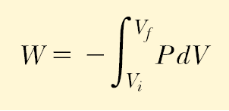


Work and heat in thermodynamic process
The total work done by the gas as its volume changes from V_{i} to V_{f} is
The work done by a gas in a quasi-static process equals the area under the curve on a PV diagram, evaluated between the initial and final states. It depends on the path between the initial and final states.

Slide 15
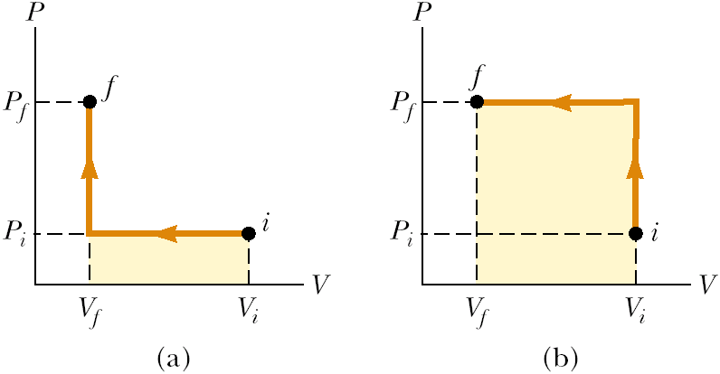
Work depends on the path:
(a): W_{a}= P_{i}(V_{f}-V_{i})
(b): W_{b}= P_{f}(V_{f}-V_{i})
1) W_{a}< W_{b} as P_{f} < P_{i}
2) W_{a} < W_{b} as the coloured area in (b) case is large then the area in (a) case

Slide 16
Two ways of energy transfer
There exist two ways in which energy can be transferred between a system and its surroundings:
  One way is work done by the system, which requires that there be a macroscopic displacement of the point of application of a force.
  The other is heat, which occurs on a molecular level whenever a temperature difference exists across the boundary of the system.
Both mechanisms result in a change in the internal energy of the system and therefore usually result in measurable changes in the macroscopic variables of the system, such as the pressure, temperature, and volume of a gas.

Slide 17
The First Law of Thermodynamics
The change in internal energy ΔU of the system is equal to the heat Q put into a system minus the work W done by the system.
ΔU= Q - W
Note: here W is with the minus sign as the work is done by the system.

Slide 18
The first law of thermodynamics is a special case of the law of conservation of energy that encompasses changes in internal energy and energy transfer by heat and work. It provides a connection between the microscopic and macroscopic approaches.

Slide 19
Ideal Gas Processes
Here W is work done by the system,
ΔQ - heat flow into the system.
Isobaric (constant pressure):
W=PΔV
dQ = C_{p}dT
Isochoric (constant volume):
ΔW = 0
ΔQ = ΔU
dQ = C_{V}dT
C_{p,} C_{V} are specific heat capacities, C_{p} = C_{V} + nR, n is the number of moles.
Isothermal (constant temperature):
ΔU = 0
ΔQ = ΔW

Slide 20
Adiabatic (no heat flow, Q=0):
ΔW = -ΔU
The curve of adiabatic process is described by formula:
PV^{γ} = const
TV^{γ−1} = const
γ=C_{P}/C_{V}=(f+2)/f
For a monoatomic ideal gas γ=5/3
For a diatomic ideal gas γ=7/5

Slide 21
Polytropic processes
PV^{γ} = const, γ=const.
Isobaric γ=0
Isotermic γ=1
Adiabatic γ= C_{P}/C_{V}
Isochoric γ=∞

Slide 22
Cyclic Processes
If a nonisolated system is performing a cyclic process, the change in the internal energy must be zero. Therefore the energy Q added to the system must equal the negative of the work W done by the system during the cycle:
ΔU = 0,
Q = W
On a PV diagram, a cyclic process appears as a closed curve. In a cyclic process, the net work done by the system per cycle, equals the area enclosed by the path representing the process on a PV diagram.

Slide 23
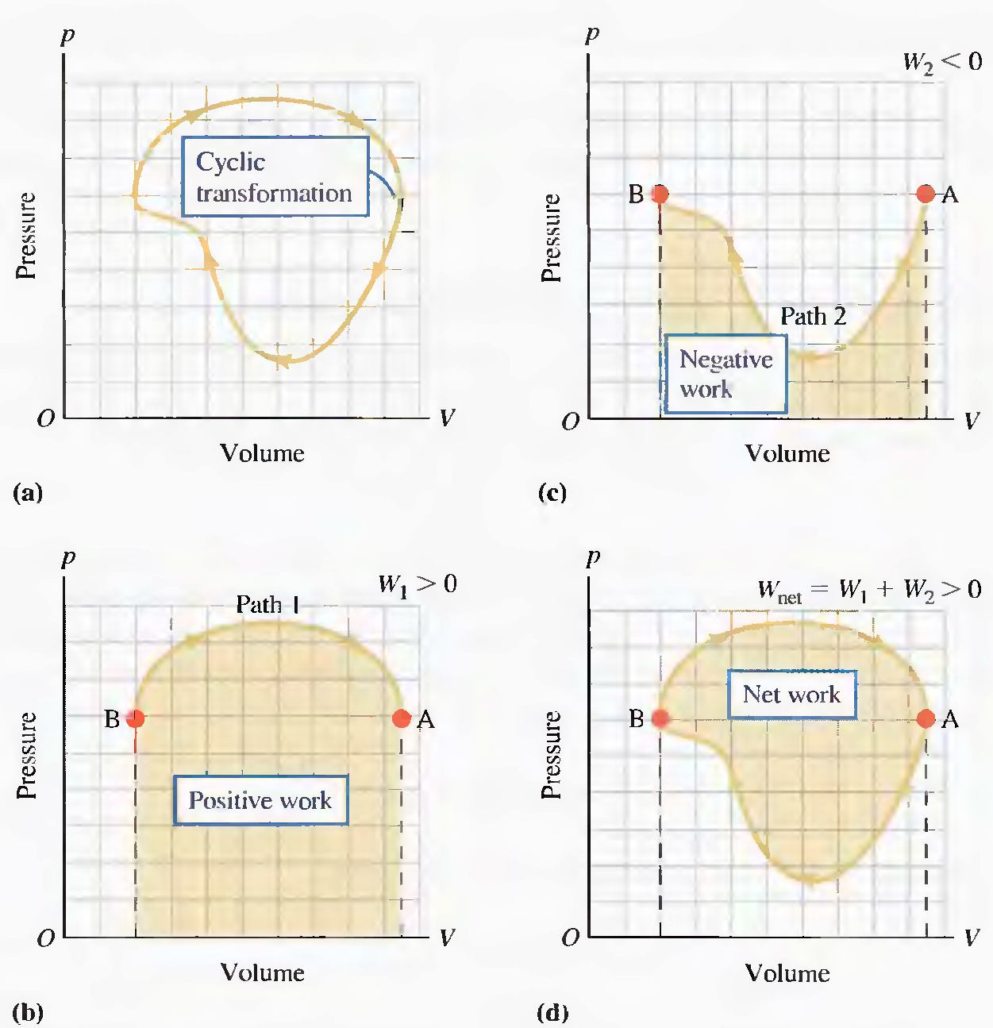
In a closed cycle, the work done by a gas on its surroundings is the area enclosed by the curve of p versus V. To show this, the full cycle is broken into two paths – the upper and the lower.

